Slide 1
Introduction to Digital Business Management
Sesi 13 – Dimensi Organisasi
Jasmine Hadiwidjojo, S.E., M.M.

Slide 2
AGENDA SESI 13
1
2
3
4
Global Dimension of Management
Multinational Corporations
Small Business Management & Entrepreneurship
New Venture Creation

Slide 3
GLOBAL DIMENSION OF MANAGEMENT

Slide 4
Globalization
Globalisasi adalah proses pengembangan mandiri yang merupakan elemen dari ekonomi global. Pada globalisasi, level manajemen tidak hanya terjadi pada 1 perusahaan saja namun pada seluruh dunia tempat cabang perusahaan tersebut berada.
International Management merupakan operasi manajemen yang berada di lebih dari satu negara.
Mengapa perusahaan go global?
Profit - menawarkan keuntungan yang lebih besar
Customers - menjangkau market baru
Suppliers - mendapatkan akses ke material baru
Capital - sumber finansial baru
Labor - mendapatkan akses sumber daya manusia dengan upah kerja yang lebih rendah

Slide 5
Bentuk Bisnis Internasional
Global Sourcing - proses membeli material, memproduksi komponen atau menyediakan jasa/bisnis/produk di luar negeri
Export - mengirimkan barang/jasa ke luar negeri
Import - mendatangkan barang/jasa ke dalam negeri
Licensing agreement - sebuah firma membayar hak untuk memproduksi produk perusahaan lain
Franchising - biaya yang dibayarkan untuk menggunakan nama/brand perusahaan lain
Ada 2 cara agar perusahaan bisa berkembang ke pasar global, yaitu melalui joint venture (co-ownership dengan perusahaan lokal) atau foreign subsidiary (operasional di daerah lokal tsb dilakukan oleh firma asing).

Slide 6
Global Business Environment
•Legal and political systems
–Differing laws and practices regarding
•Business ownership
•Foreign currency exchange
•Protection of intellectual property rights
–Counterfeit merchandise
–Political risk
•Potential loss in value of a foreign investment due to instability and political changes in the host country
–Political risk analysis
•Forecast political disruptions that threaten the value of a foreign investment

Slide 7
Ethical Challenge
•Corruption – illegal practices that further one’s business interests
•Sweatshops – employ workers at very low wages for long hours in poor working conditions
•Child labor –full time employment of children for work otherwise done by adults

Slide 8
MULTI NATIONAL CORPORATION

Slide 9
Multi National Corporation
Multi National Corporation (MNC) adalah sebuah firma bisnis dengan pengembangan operasional secara internasional dan berada di lebih dari 1 negara. Contoh perusahaan MNC seperti IKEA, McDonalds, Toyota, Mitsubishi, Sony, dsb.
MNC Pros & Cons :

Slide 10
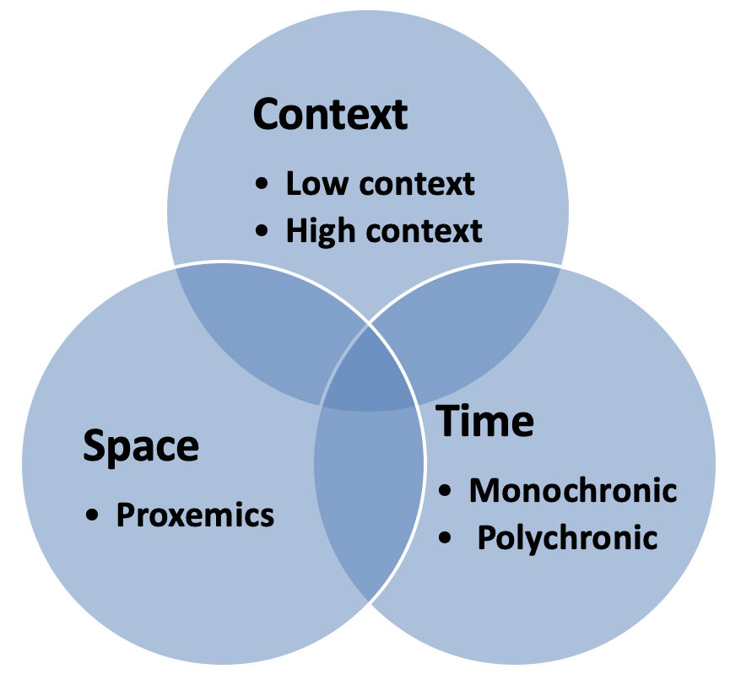
Silent Language of Culture
Notes:
–Low context cultures - emphasize communication via spoken or written words
•United States
•Canada
•Germany
–High context cultures – rely on nonverbal and situational cues as well
as on spoken or written
words
•Thailand
•Malaysia
Time
–Monochronic cultures – people tend to do one thing at a time
•United States, Canada, Germany
–Polychronic cultures – time is used to accomplish many different things at once
Egypt, Saudi Arabia, Mexico
Space
–Proxemics – study of how people use space to communicate
•In the U.S. people value “personal space”
Many Latin and Asian cultures expect much less personal space
Tight and Loose Cultures
–Cultural tightness-looseness
•Strength of norms that govern social behavior
•Tolerance for any deviance from norms
•Tight = Japan, Korea
Loose = Brazil, Hungary

Slide 11
Culture & Global Diversity
Sebuah hal lumrah ketika seseorang berkunjung ke negara lain, ia mengalami culture shock. Hal yang sama juga berlaku bagi perusahaan yang ingin masuk ke ranah global.
Culture shock adalah kebingungan & ketidaknyamanan yang seseorang rasakan ketika berada di budaya yang ia tidak familiar.
Menurut Hofstede, national culture bisa dibagi menjadi 5 yaitu:

Slide 13
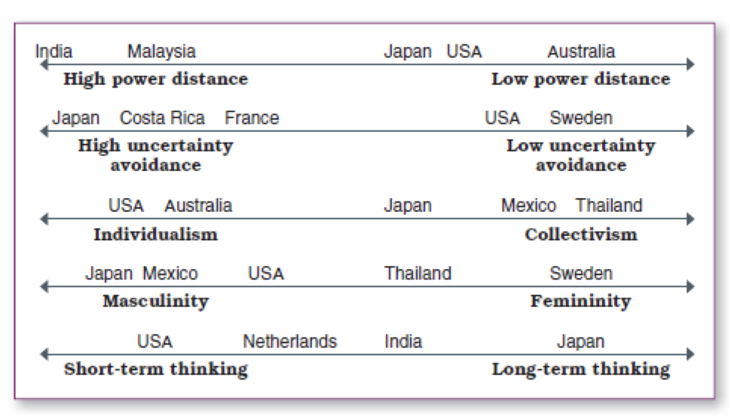
Contoh penerapan Hofstede National Culture:

Slide 14
Global Learning Goals:
–Not universal
–Engage critical thinking
–Look everywhere for new management ideas
–Always consider culture!

Slide 15
Entrepreneurship

Slide 16
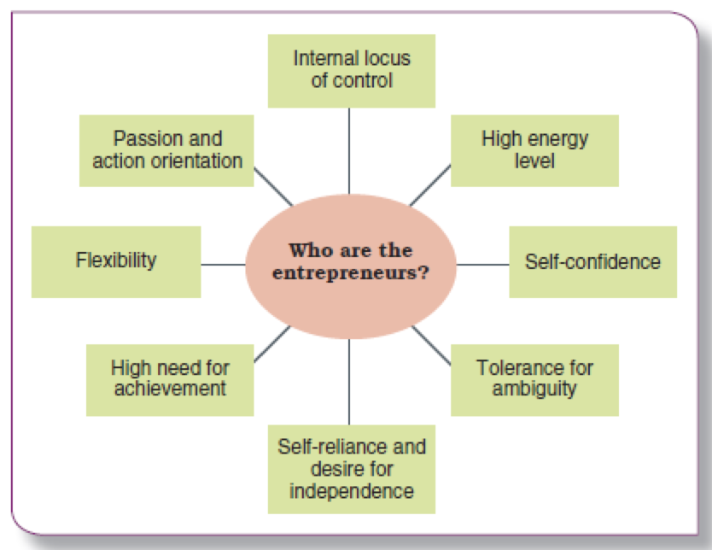
Nature of Entrepreneurship

Slide 17
Entrepreneurship
Entrepreneurship adalah sebuah pemikiran strategis dan didukung sikap pengambilan keputusan yang menghasilkan sebuah peluang baru untuk individu atau organisasi (Schermerhorn, 2008).
Seorang Entrepreneur rela untuk mengejar kesempatan di situasi yang dinilai orang lain sebagai problem atau ancaman.
Contoh Entrepreneur:
Richard Branson
Jeff Bezos
Elon Musk

Slide 18
Entrepreneurship
•Necessity-based entrepreneurship
–People start a business because no other
employment opportunities exist
Social entrepreneurship
–Unique form of ethical entrepreneurship that seeks new ways to solve pressing social problems
Intrapreneurs
–Display entrepreneurial behavior as employees of larger firms

Slide 19
Small Business

Slide 20
Small Business
•Provide just over 55% of private-sector workers
•Create as many as 6 out of 10 new jobs
•Employ 40% of high-tech workers
•Receive 35% of federal government contract dollars
•Export more than $500 billion worth of goods and services annually
A small business has fewer than 500 employees

Slide 21
Starting Small Business
–Franchise
•One business owner sells to another the right to operate the same business in another location
–Business model
•Plan for making a profit by generating revenues that are greater than costs
–Startup
•New and temporary venture that is trying to establish a profitable business model
–Lean startups
•Use open source software and free web services to contain costs while staying small and keeping operations simple

Slide 22
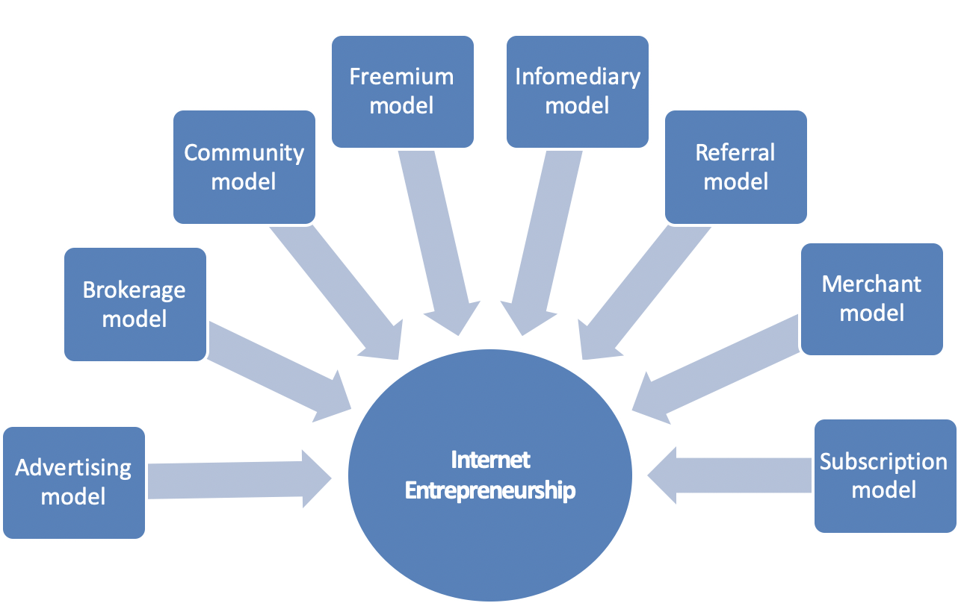
Web-Based Business Model

Slide 23
Family Business Model
Family owned businesses
–Account for 78% of new jobs created in the U.S.
–Provide 60% of the nation’s employment
–Feuds result when family members disagree over how the business is run
–Possible succession problems
•Who will run the business when the current head leaves?
•Succession plan outlines leadership transition and financial matters

Slide 24
Why Small Business Fail?
SBA reports that as many as 60 to 80% of new businesses fail in first five years
Reasons why small businesses fail
- Lack of experience - Lack of expertise
- Lack of commitment - Growing too fast
- Lack of strategy - Lack of strategic leadership
- Ethical failure - Poor financial control

Slide 25
New Venture Creation

Slide 26
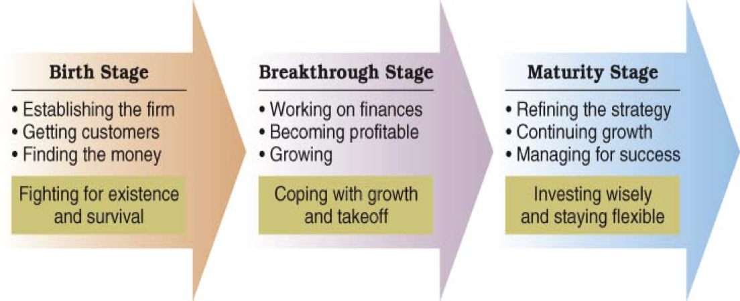
Life Cycle of Entrepreneurial Firm

Slide 27
Small Business Development
–Business incubator
•Offers space, shared services and advice to get small businesses started
Contoh: UC Venture Lab (lantai 1 Corepreneur)
–Small Business Development Centers
Founded with U.S. Small Business Administration to provide advice to new and existing small businesses
Contoh: program yang diselenggarakan perusahaan besar seperti Gojek Xcelerate yang akan menghubungkan small business dengan investor

Slide 28
Untuk membuat ventura bisnis,
Anda membutuhkan Business Plan
Business plan
–Describes the direction for a new business and the financing needed to operate it
–Banks want to see a well-developed business plan before loaning money

Slide 29
Kerangka Business Plan:
Sample Business Plan Outline:
–Executive Summary
–Industry Analysis
–Company description
–Products and services description
–Market description
–Marketing Strategy
–Operations description
–Staffing description
–Financial projections
–Capital needs
–Milestones

Slide 30
Ownership (Kepemilikan)
–Sole Proprietorship
An individual or married couple pursuing business for a profit. This does not involve incorporation
–Partnership
Two or more people agree to contribute resources to start and operate a business together

Slide 31
Ownership (Kepemilikan)
–Corporation
A legal entity that exists separately from its owners
–Limited Liability Corporation (LLC)
A combination of sole proprietorship, partnership, and corporation
–Protects owners against personal loss other than what is invested in the company
–Treated as a proprietorship or partnership for tax purposes

Slide 32
Financing (Debt)
–Debt Financing
involves borrowing money from another person, a bank, or a financial institution
–Equity Financing
involves exchanging ownership shares for outside investment monies
–Venture Capitalists
Involves making large investments in new ventures in return for an equity stake in the business
–Angel Investor
A wealthy individual willing to invest in return for equity in a new venture
–Initial Public Offering (IPO)
An initial selling of shares of stock to the public at large

